Slide 1

TRACKING CORONA VIRUS

Slide 2

CMR COLLEGE OF ENGINEERING &TECHNOLOGY
Kandlakoya,Medchal,Hyderabad-5051401
Department of Computer Science and Engineering
TRACKING CORONA VIRUS
BATCH-21
19H51A0550-N.Thomas
19H51A0551-N.Sahithi
19H51A0521-R.Rakshith
Under esteemed guidance of
Dr.D.Murali

Slide 3
OUTLINE
Analysis Results
Software
UML Diagram
Flow Chart
Advantages
Conclusion
References
Abstract
Introduction
Objectives
Literature survey
-Existing solutions
- Disadvantages of existing solutions
Proposed solution
Libraries
v

Slide 4
Abstract
Coronavirus Disease (COVID-19) is an infectious disease caused by a newly discovered virus called Coronavirus. This COVID-19 is declared as a pandemic by WHO. It affects different people in different ways, its impact has been deleterious from both health perspective and an economic one which cannot be expected by us. So, let us have some idea on how it effects on the world, what are the death rates, recoveries in each place by the present technology. Now we are giving analysis on the data of COVID-19 for the awareness by statistical reports on its exponential growth and to take preventive measures to be safe from COVID-19 and to know what happening around us and how it effects.
So, we are using data driven technologies to make a case study on COVID-19. We are going to visualize the data which we collected using Python packages like plotly , folium, seaborn etc. The Data Set we collected is country wise and it is taken from the 2019 Novel Coronavirus Visual Dashboard operated by the Johns Hopkins University Center for Systems Science and Engineering (JHU CSSE).

Slide 5
Introduction
Coronaviruses are a large family of viruses that are known to cause illness ranging from the common cold to more severe diseases such as Middle East Respiratory Syndrome (MERS) and Severe Acute Respiratory Syndrome (SARS).
In this project, you will learn how to preprocess and merge datasets to calculate needed measures and prepare them for an Analysis. we are going to work with the COVID19 dataset, which consists of the data related to the cumulative number of confirmed cases, per day, in each Country.
We are going to analysis the covid by comparing different countries and understanding how it is changing day by day.
We also provide with daily news updates on Covid from varies countries and number of covid cases also.

Slide 6
Objectives
Confirmed tested cases of Coronavirus infection
We going to compare with other diseases like Ebola, H1N1 etc...
The number of people who have reportedly died while sick with Coronavirus.
The number of people who have reportedly recovered from it.
We are going to provide with Daily news Updates.

Slide 7
Literature survey
Existing Solution
GOVERNMENT COVID TRACKER :
Government of India is taking all necessary steps to ensure that we are prepared well to face the challenge and threat posed by the growing pandemic of COVID-19 the Corona Virus.
The most important factor in preventing the spread of the Virus locally is to empower the citizens with the right information and taking precautions as per the advisories being issued by Ministry of Health & Family Welfare.

Slide 8
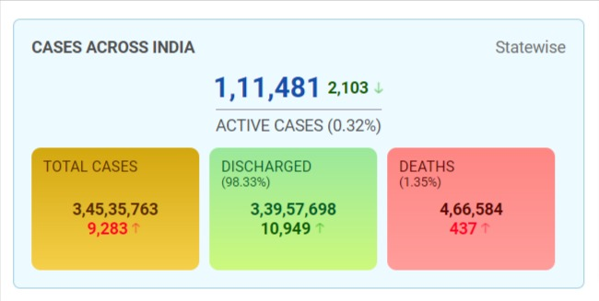
This website will provide total number of active cases.
Total number of people discharged and total deaths till present date.
It also provide the information in state wise also.
And the total number of people vaccinated.

Slide 9
Disadvantages of existing solution:
The website will not provide the visualization of covid 19 cases, recoveries, deaths.
By visualizing the previous data we can predict the future and take measurable precautions.
It is not having breaking news related to COVID.
The website does not have different countries covid covid cases, recoveries, deaths.
It does not provide some visualization through graphs or heat maps, by providing this it will we easy to understand the current situation of covid in the present place.

Slide 10

Proposed solution
TRACKING CORONA VIRUS

Slide 11
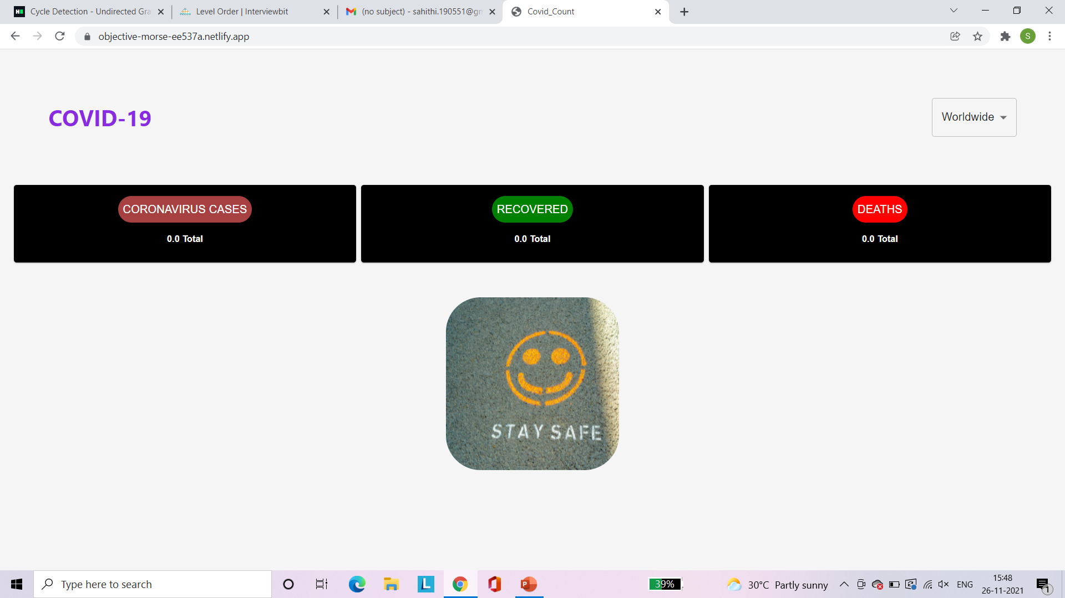
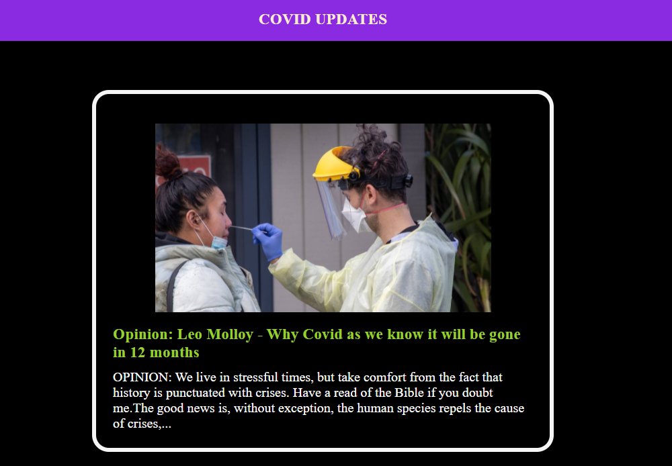
Covid Cases
Covid News

Slide 12
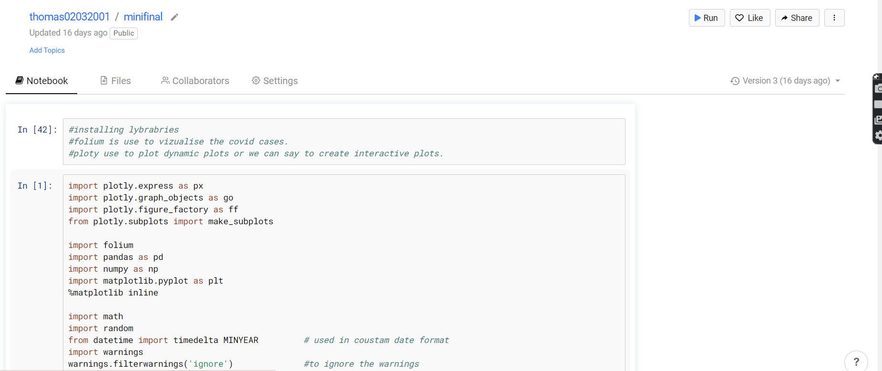
COVID ANALYSIS

Slide 13
1] Libraries
Plotly Python = The Plotly Python library is an interactive open-source library. It can plot various types of graphs and charts like scatter plots, line charts, bar charts, box plots, histograms, pie charts, etc.
Pandas = Pandas has been one of the most popular and favorite data science tools used in Python programming language for analysis. And Pandas is seriously a game changer when it comes to cleaning, transforming, manipulating and analyzing data. In simple terms, Pandas helps to clean the mess.
NumPy = Using NumPy, mathematical and logical operations on arrays can be performed.

Slide 14
2] Importing COVID19 dataset and preparing it for the analysis by dropping columns and aggregating rows.
The dataset used here are collected from Novel Coronavirus Visual Dashboard operated by the Johns Hopkins University Center for Systems Science and Engineering (JHU CSSE).
The dataset are :- country_daywise, countrywise, daywise, c19.
We also created dataset confirmed, recovered, deaths from the dataset c19 and grouped them together by Date.

Slide 15
3] Checking for null values and filling the dummy values.
Checking our data contains any null values.
If our data contains null value it will not give the desired output so we are going to replace the null values with any value or we can delete the column or the row.
To check our data contains null values we can use “isnull()” which will output the number of null values in each column.
In out dataset c19 we are having null value to the column “Province/State” so we are filling it with empty string.

Slide 16
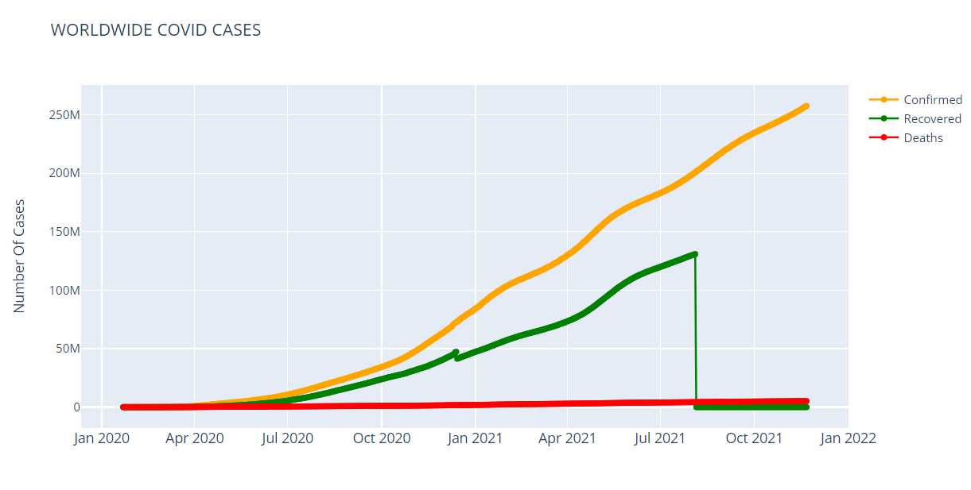
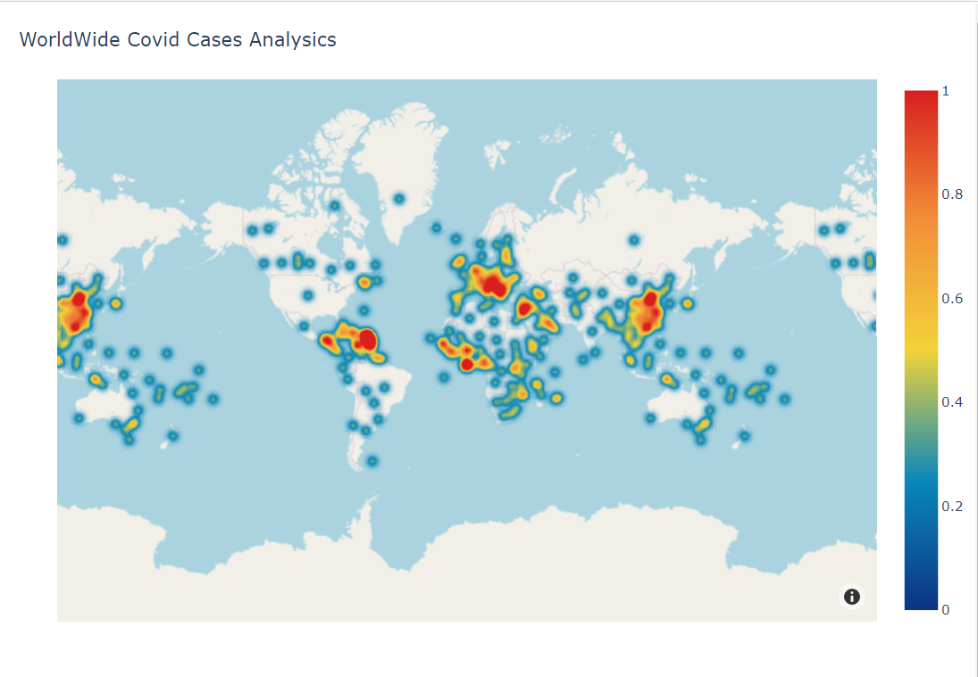
Visualizing our analysis results
SCATTER GRAPH
Density Map Box

Slide 17
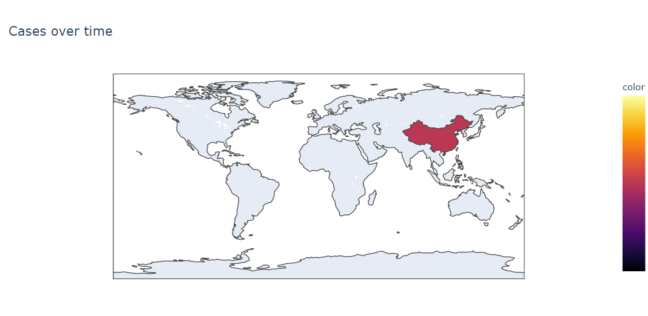
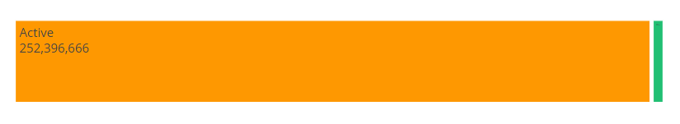
Tree Map
Choropleth map

Slide 18
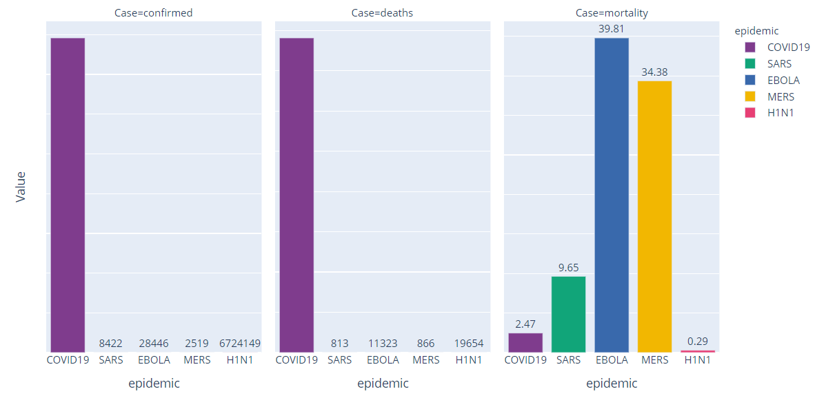
Few more Visualizing …
Deaths and recoveries per 100 cases.
Number of new cases and number of new countries effected by covid.
Top 15 countries analysis.
Comparing Covid-19 with other diseases like EBOLA, H1N1, SARS, MERS.

Slide 19
Software:-
SOFTWARE INTERFACE
Operating system : Windows 11
DBMS : MongoDB.
Compiler : Visual studio code && Jupyter
Front-end tools : React

Slide 20
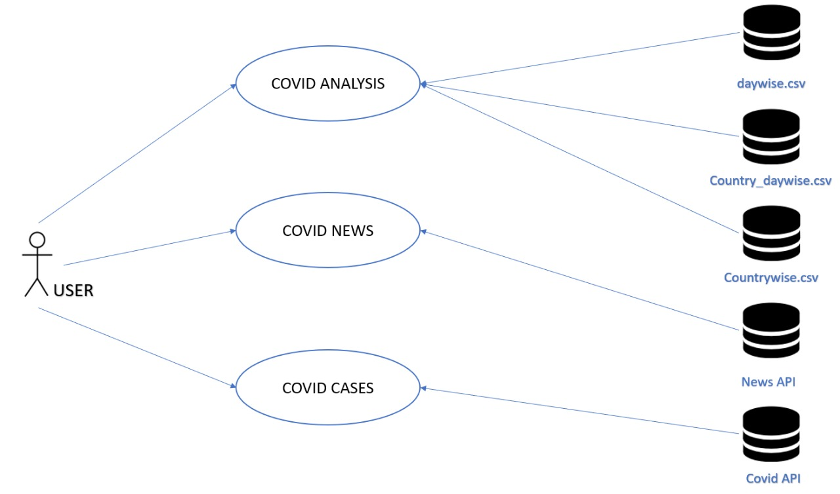
UML DIAGRAM

Slide 21
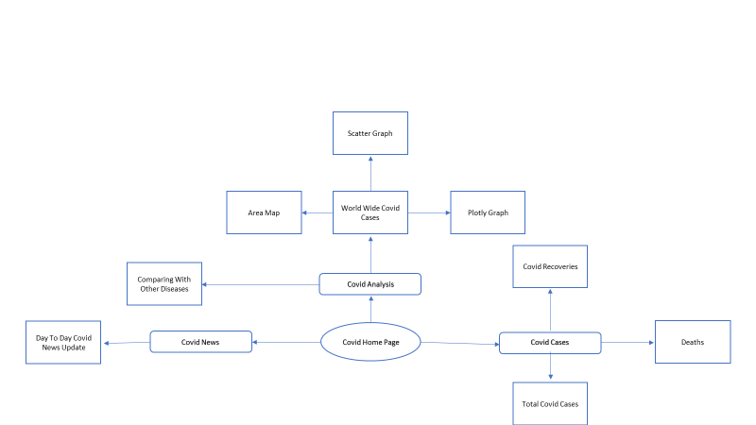
Flow Chart

Slide 22
Advantages
The advantages through these covid tracker is we can predict the future conditions and situations about the cases, through the record of data collected from various souces.it helps the people all over the to take certain precautions and safety measures though the analysis which we provide.
We can also get news update on Covid.
User can see all countries covid cases, recoveries, death in one place.

Slide 23
Conclusion
The idea we made helps us to predict the worldwide covid cases in various countries .
We can predict number of deaths, recoveries and information about covid data.
We are linked with a news page which provides day to day updates about covid cases.

Slide 24
References
https://www.analyticsvidhya.com/blog/2021/02/an-intuitive-guide-to-visualization-in-python/
https://www.lighthouselabs.ca/en/blog/the-five-stages-of-data-analysis
https://www.lighthouselabs.ca/en/blog/the-five-stages-of-data-analysis
https://www.jovian.ai/

Slide 25


